Slide 1
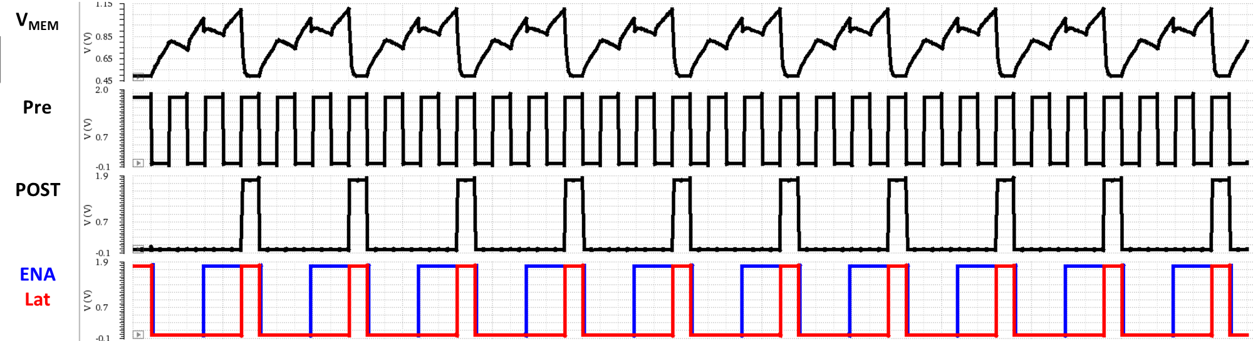
Low Power Comparator Operation with Predictor
for Spiking Neural Network
Gyuwon Kam, Dahyeon Youn, Jiin Moon, Sooyoun Kim, Minkyu Song
Department of Semiconductor Science, Dongguk University
onegg99@dgu.ac.kr
This study proposes prediction block to reduce the neuron power consumption by predicting the output spike. In the SNN system, even when the difference between the membrane voltage and the threshold of the neuron is large, the comparator always operates and consumes unnecessary power. When the difference between the membrane voltage and the threshold voltage is 100 mV or less, the predictor generates a signal that operates the comparator. The prediction block reduces the neuron's power consumption during inference by more than 30%
1. Spiking Neural Network
3. Neuron circuit
Von Neumann Architecture
Bottleneck
With the creation of a large amount of data, Von Neumann Archtecture has limitation in processing. As a result, neuromorphic computing technology of low-power and high-efficiency operations is required.
SNN (Spiking Neural Network) is a neuromorphic system based on biological neural network operations in the brain.
The synapse current is flowed through the current mirror, and the membrane voltage is increased by the capacitor.
The ENA signal is turned on when exceeding V_{pd}(prediction voltage). The comparator operates when the ENA signal is turned on, and the spike comes out when V_{mem}(membrane voltage) is higher than the V_{th}(threshold voltage).
<3>
4. Simulation results
weight
<4>
inference
Full chip
Full Block diagram
.
.
.
<5>
Pre-neuron
Synapse
membrane voltage
Post-neuron
9 Pixel
6 Post
Through integration & fire process, spike comes out and neuron with a large number of output spike are inferred as the answer.
This study implements a SNN system optimized for the MNIST dataset in hardware.
2. Main concept
SNN system with 9 input, 6 output nodes was implemented through a circuit, and the low-power operation of the neuron circuit was aimed.
V_{th}
V_{th}
V_{mem}
V_{mem}
(a)
(b)
Figure (a) shows a section that does not require a comparator operation, and figure (b) shows a neuron that does not require a comparator operation.
V_{th}
w/ Predictor
Case1. Large weight
Case2. Small weight
V_{pd}
w/o Predictor
 | V_{DD} = 1.8V | Neuron
w/o Predictor | Current | 3.682uA
 | Power | 6.627uW
w/ Predictor | Current | 2.580uA
 | Power | 4.643uW
 | V_{DD} = 1.8V | Neuron
w/o Predictor | Current | 3.742uA
 | Power | 6.736uW
w/ Predictor | Current | 2.580uA
 | Power | 3.751uW
ENA
POST
Considering the power consumption of the comparator, this study propose a prediction circuit that sends an ENA signal that operates the comparator only when necessary.
29.94% ↓
44.31% ↓
The chip fabrication was supported by
the IC Design Education Center(IDEC), Korea.

